Slide 1

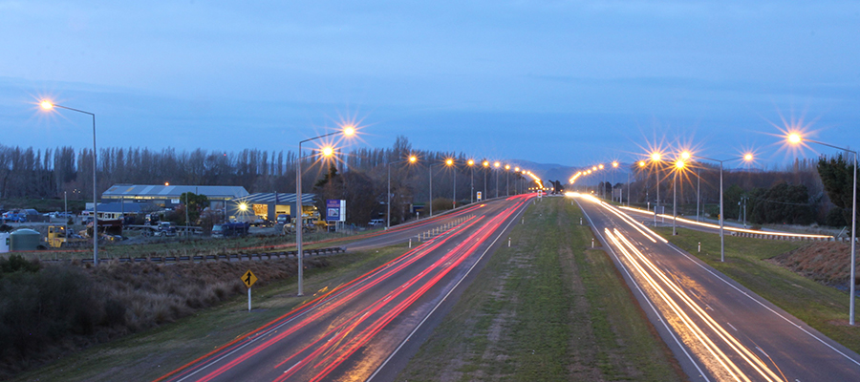
DATA201 Road Data Presentation
Daniel, Case, Paul and Lida

Slide 2


INTENDED USE OF DATA

Slide 3
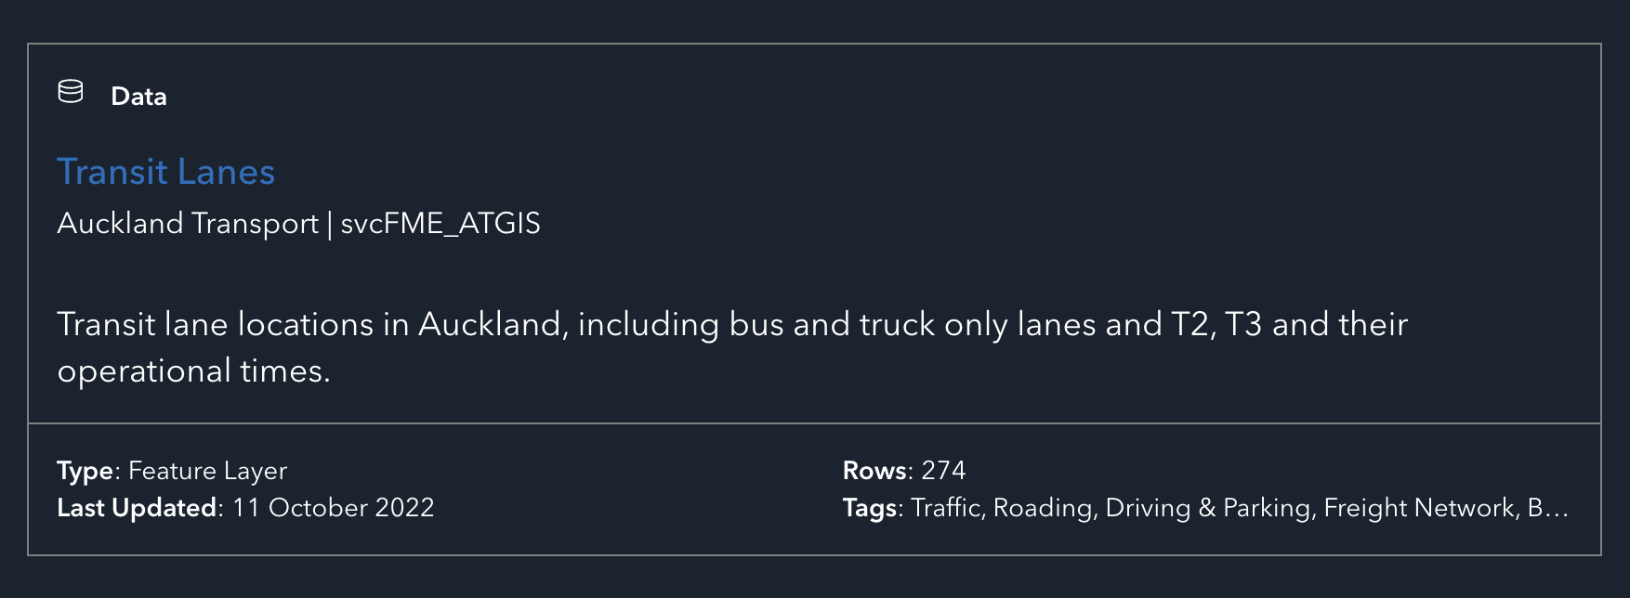
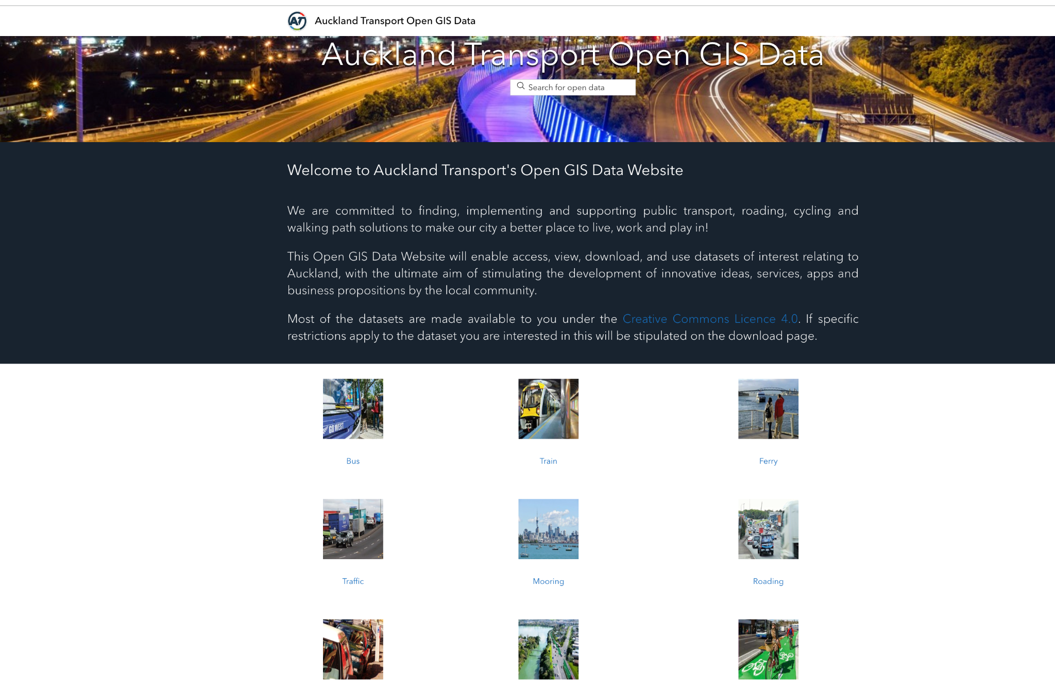
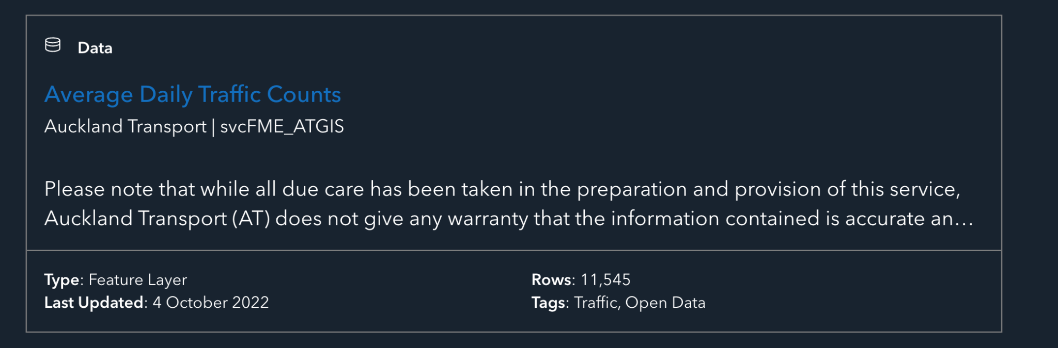
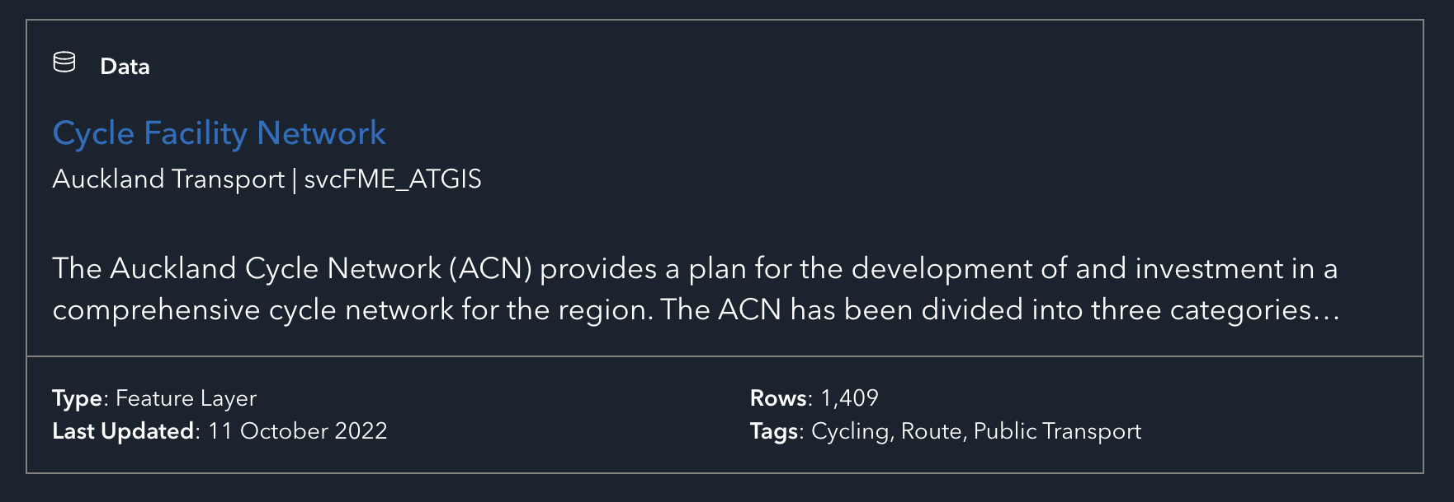
Source of Data

Slide 4
Initial challenge: Finding data
Non-clean data is very hard to find.
Information regarding data was limited.
Rows of missing values.

Slide 5
Target data model
Create a dashboard that contains road related data. The auckland council may want to use this for data analysis.
Each dataset is related by road name.

Slide 6
Transit Lanes
Transit lane dataset from auckland council. Transit lanes are an interesting choice for data as it could allow some intriguing questions to be answered, e.g traffic count on roads without transit lanes vs roads with transit lanes.

Slide 7
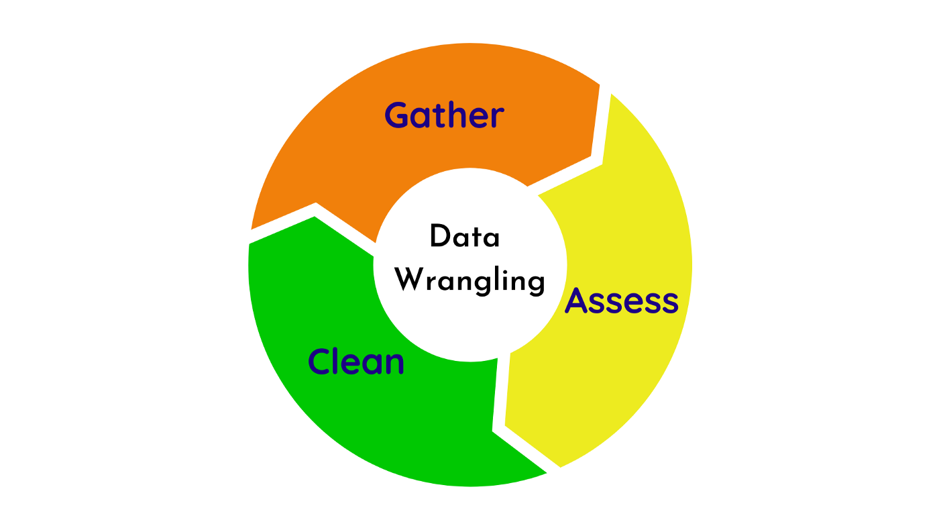
Wrangling the transit data set
Appropriate libraries:
library(tidyverse)
library(httr)
library(jsonlite)
library(visdat)
#Just importing the necessary libraries.

Slide 8
Using an API to grab the data
get_transit = GET(url = "https://services2.arcgis.com/JkPEgZJGxhSjYOo0/arcgis/rest/services/OpenData_TransitLanes/FeatureServer/0/query?where=1%3D1&outFields=*&outSR=4326&f=json")
#https://www.geeksforgeeks.org/accessing-rest-api-using-r-programming/ - This page was very helpful in using the API
#Here I have just used HTTR to grab the data from the API.

Slide 9
Finally to a dataframe
get_transit_dataframe = as.data.frame(get_transit_json$features)
get_transit_dataframe
Notes:
#I have converted the json into a dataframe. Just as a note I had to use get_transit_json$features as this is the part of the json that contains the data. I was getting errors without specifying $features.
#I will start some wrangling in the next cell.

Slide 10
Converting the raw data to text
get_transit_text = content(get_transit, "text", encoding = "UTF-8") #Converting the retrieved data into text. This is done so we can convert into a json and eventually a list or dataframe.
get_transit_text
Notes:
#Converting the retrieved data into text. This is done so we can convert into a json and eventually a list or dataframe.
#Here I have converted the data retrieved from the API into text. This will allow me to convert the data into a json and eventually a dataframe.

Slide 11
Text to JSON
get_transit_json <- fromJSON(get_transit_text, flatten = TRUE) #Converting into a JSON
get_transit_json
Notes:
#I have converted the text into a json. This is so I can now convert this into a dataframe and start doing some wrangling.

Slide 12
Dropping a column
#Getting rid of the extra geometry.paths column which isn't helpful to us and wasn't in the original dataset.
get_transit_df = get_transit_dataframe %>% select(-c(geometry.paths))
get_transit_df

Slide 13
Renaming columns
Removing .attributes.
#https://www.tutorialspoint.com/how-to-remove-a-common-suffix-from-column-names-in-an-r-data-frame - This page was very helpful in making this process much quicker.
#Using gsub to remove common words in column names:
colnames(get_transit_df) = gsub("attributes.", "", colnames(get_transit_df))
get_transit_df

Slide 14
Dropping observations
get_transit_df %>% vis_miss(cluster = TRUE)
get_transit_df %>% glimpse()
get_transit_df2 = get_transit_df %>% filter(!is.na(LANESTART) & !is.na(LANEEND))
get_transit_df2
get_transit_df2 %>% vis_miss(cluster = TRUE)

Slide 15
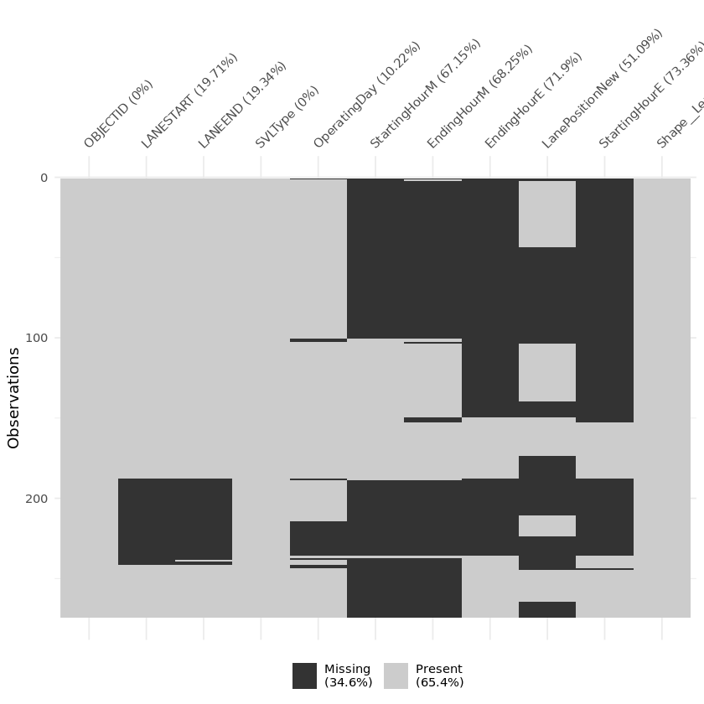
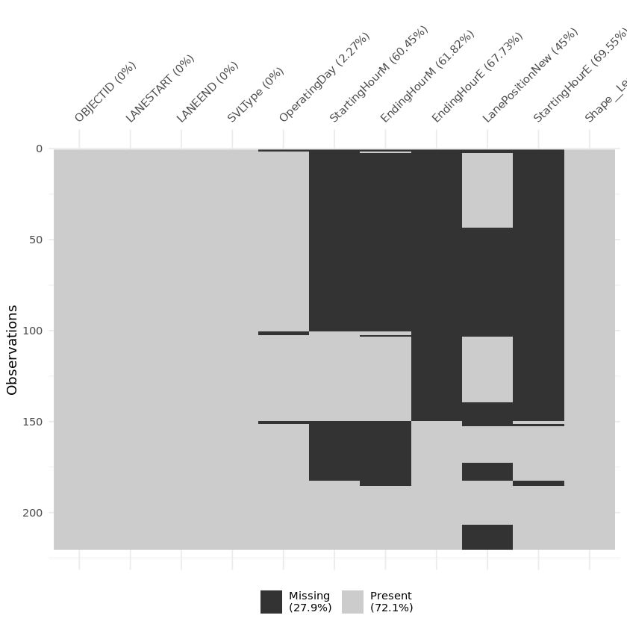
Vis_miss results
Before: After:

Slide 16

Example of the unclean data

Slide 17

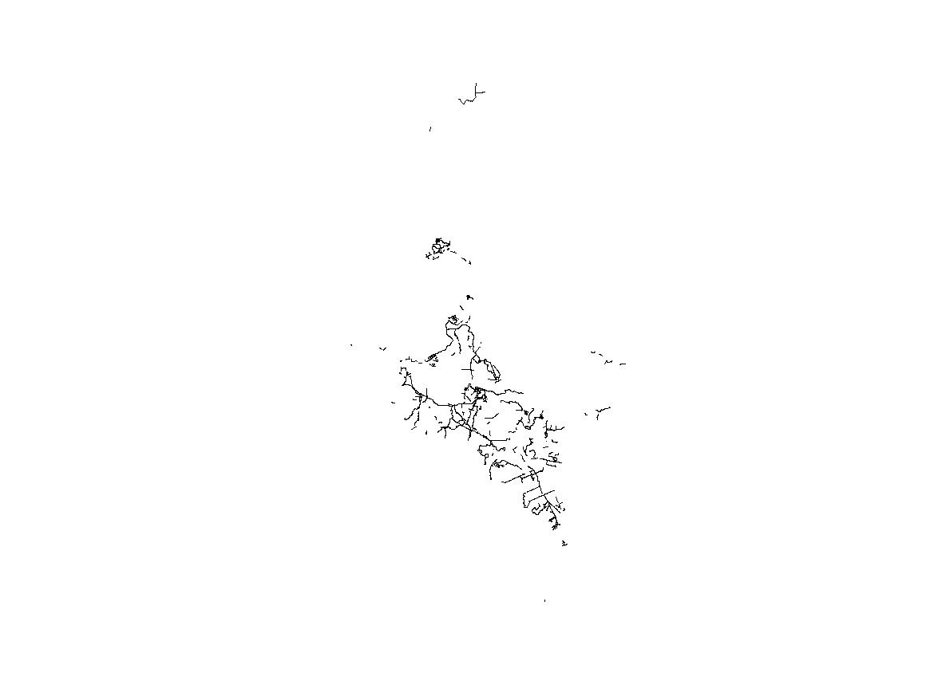
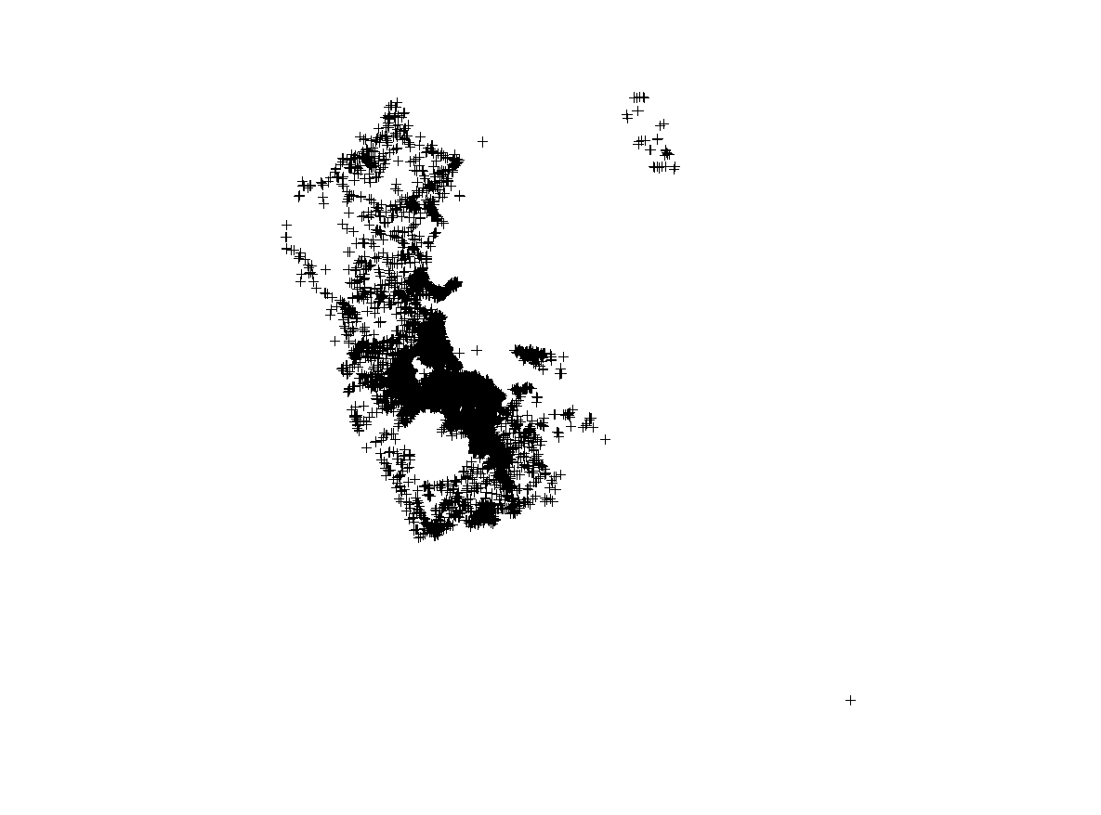
What didn’t go so well
Plotting geojson files. Ggmap functions either don't work or require API key.
Traffic count: Transit lanes: Cycle lanes:

Slide 18
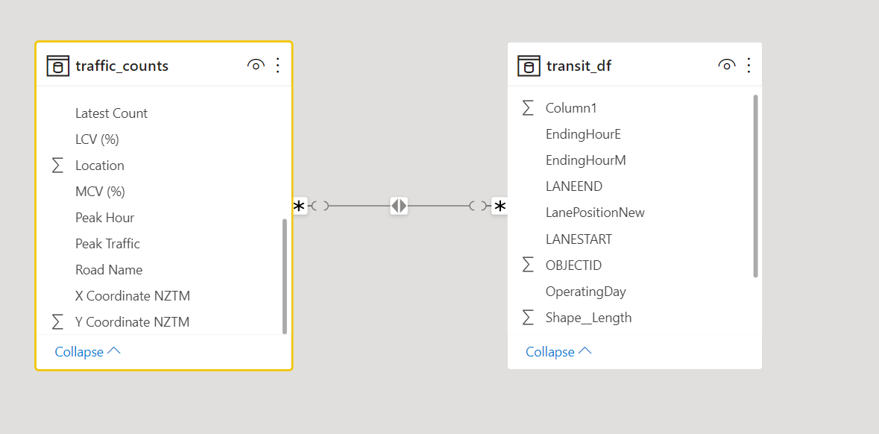
Data model

Slide 19

Challenges during wrangling
Deciding what to do with NA values. Get rid of them? Change parse? Leave them?
Had to decide if dropping columns or observations was going to be worth it or just a loss of information.

Slide 20
Plotting geojson code
library(geojsonio)
transit_spatial = geojson_read("https://data-atgis.opendata.arcgis.com/datasets/ATgis::transit-lanes.geojson?outSR=%7B%22latestWkid%22%3A2193%2C%22wkid%22%3A2193%7D", what = "sp")
plot(transit_spatial)
volume_spatial = geojson_read("https://data-atgis.opendata.arcgis.com/datasets/ATgis::average-daily-traffic-counts.geojson?outSR=%7B%22latestWkid%22%3A2193%2C%22wkid%22%3A2193%7D", what = "sp")
plot(volume_spatial)
cycle_spatial = geojson_read("https://data-atgis.opendata.arcgis.com/datasets/ATgis::cycle-facility-network.geojson?outSR=%7B%22latestWkid%22%3A2193%2C%22wkid%22%3A2193%7D", what = "sp")
plot(cycle_spatial)

Slide 21

What did we have to learn?
Grabbing a geojson file using geojsonio and plotting it.
Using jsonlite, wrangling raw api data into a dataframe.
Using Microsoft PowerBI to create a dashboard.

Slide 22
Traffic counts
A dataset from Auckland Transport that contains transit lanes and counts of various types of traffic including cars, buses and different categories of heavy commercial vehicles (HCVs)

Slide 23
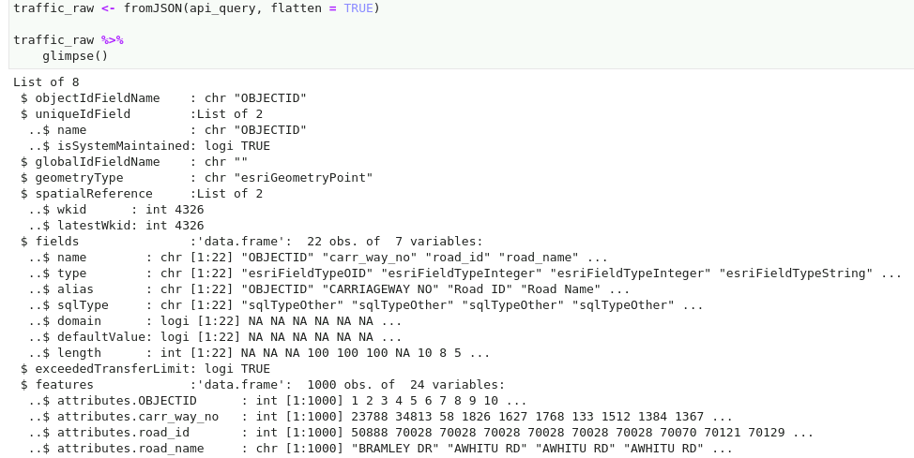
Cleaning the data
Removed ‘attributes’ section in a different way - using other elements of API response

Slide 24
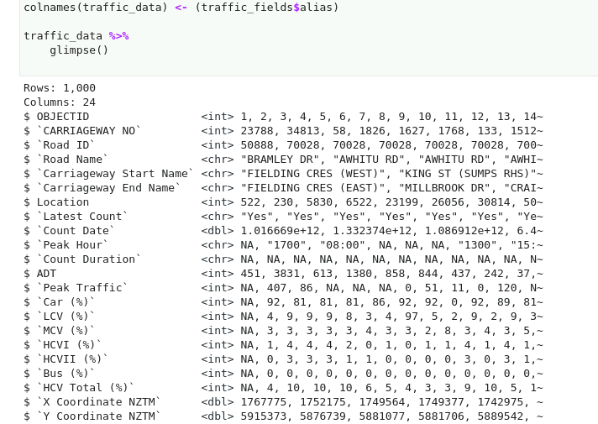
Cleaning the data

Slide 25

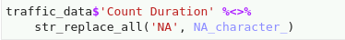
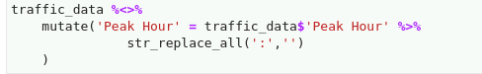
More cleaning
stringr and str_replace_all were very useful

Slide 26

Challenges
Exceeded transfer limit
Converting UNIX timestamp to date (overflows with default values)
Joining Datasets (primary keys are not unique across datasets)

Slide 27


